Slide 1




Mathematical Sciences for Global Challenges Research Fund (GCRF) initiatives
Surajit Ray, University of Glasgow
19 - 21 October 2020

Slide 2
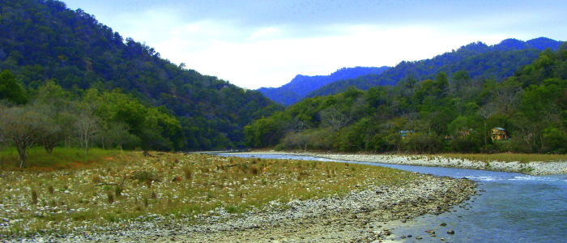








PI of EPSRC-GCRF project “Developing statistical downscaling to improve water quality understanding and management in the Ramganga sub-basin”
Application: Water Quality
Statistical methodology: Fuse data from multiple sources to understand spatial and temporal water quality patterns.
Partner Institutions and Multidisplinary team
Supporting Partners
2

Slide 3
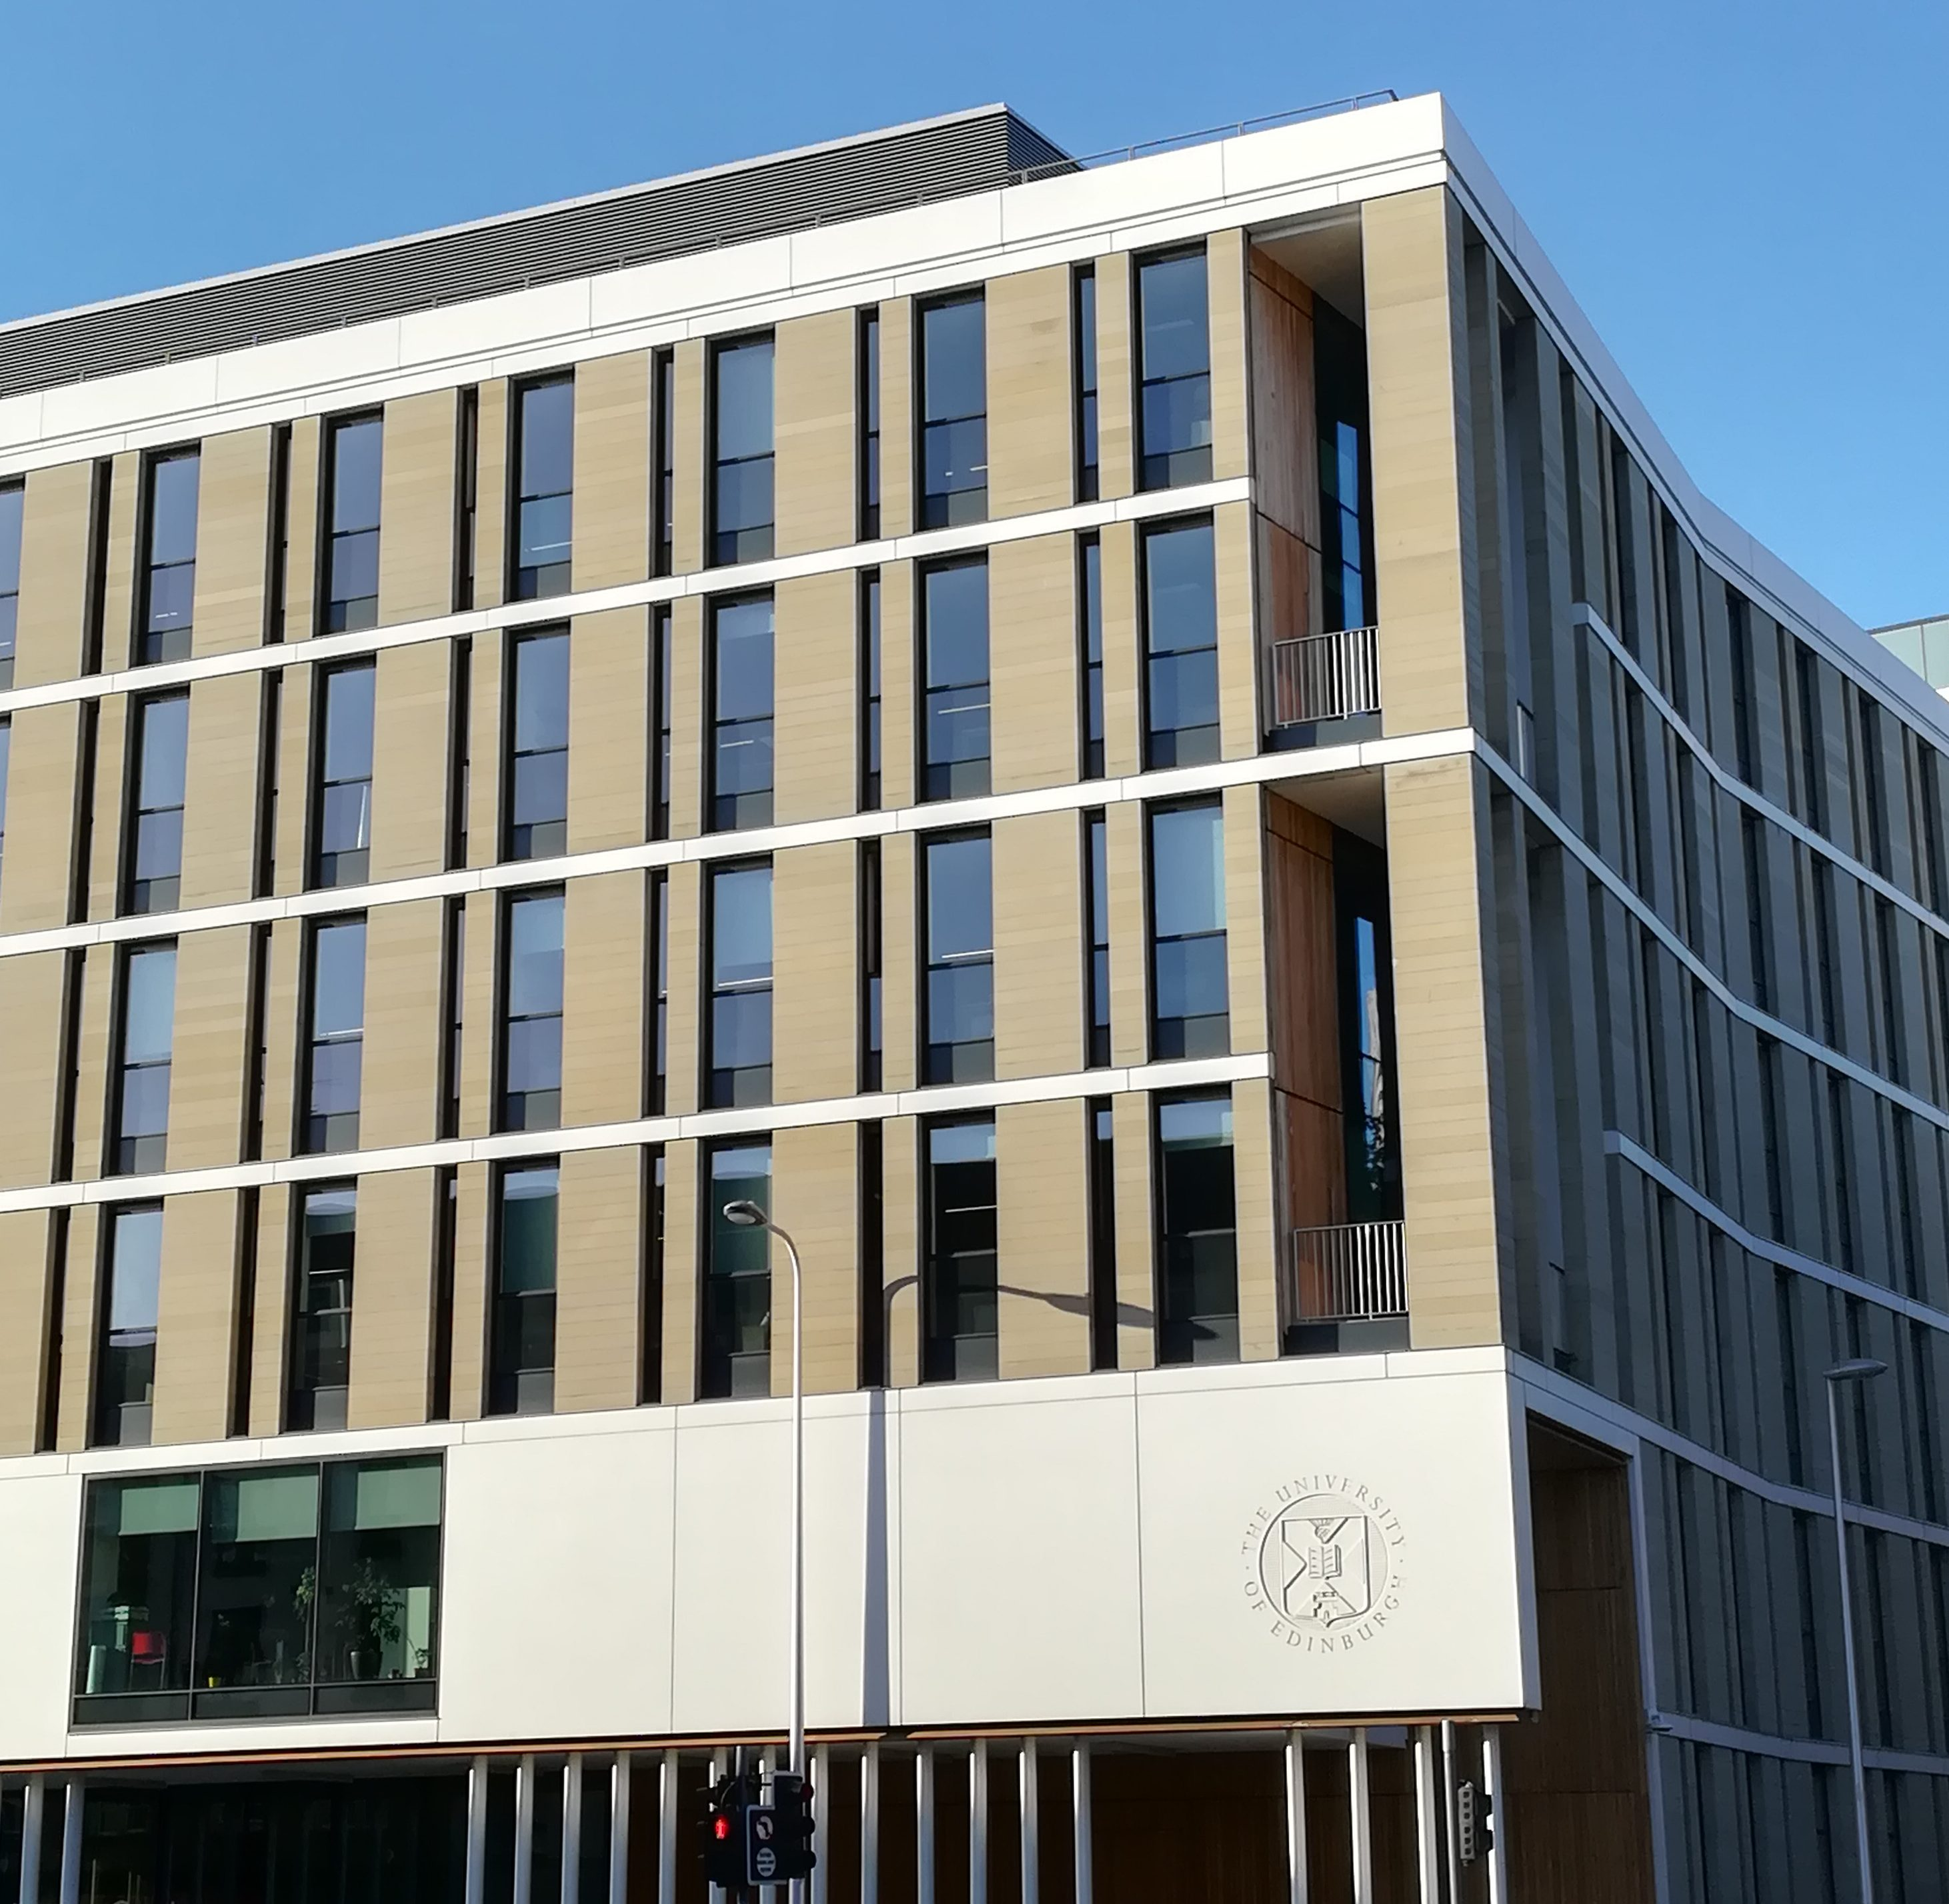
Organizers
Schönlieb, Professor C-B. | University of Cambridge
Dryden, Professor IL | University of Nottingham
Harper, Professor PR | Cardiff University
Wilkinson, Professor RD | University of Sheffield
Zografos, Professor K | Lancaster University
Prada, Dr JM | University of Surrey
Giorgi, Dr E | Lancaster University
Madzvamuse, Professor A | University of Sussex
Szendroi, Professor B | University of Oxford
Faraway, Professor JJ | University of Bath
Trotter, Dr CL | University of Cambridge
Scaparra, Professor MP | University of Kent

Slide 4
Welcome
All participants
Special thanks to all organizers
ICMS
Scientific Director Professor Paul Glendinning
Centre Manager Jane Walker
All invited speakers --- for agreeing in such a short notice

Slide 5
Previous Activities at ICMS
Feb 2018: to consider the capacity for and capability of the mathematical sciences community in the UK to produce major impact in the research themes funded through the GCRF.
Math GCRF directory
Dec 2018: After the EOI stage of the call
2

Slide 6
Goals of this strategic workshop
Provide a much-needed venue for interaction Mathematical Sciences community to
identify new global challenges arising in LMIC countries
propose novel mathematical and statistical solutions to these challenges,
foundation for establishing long-term and fruitful collaborative groups who will be able to compete for larger open GCRF calls
Provide a forum to develop synergies among currently funded EPSRC-GCFR grants
Showcase mathematics for GCRF and encourage others to join
Notes:
The synergistic activities arising from this workshop will lead us to build a larger network of researchers, identify challenge driven research and/or capacity building calls which can be led by members of the mathematical sciences community.

Slide 7


Global context: UN Sustainable Development Goals
3
https://sustainabledevelopment.un.org/topics/sustainabledevelopmentgoals

Slide 8
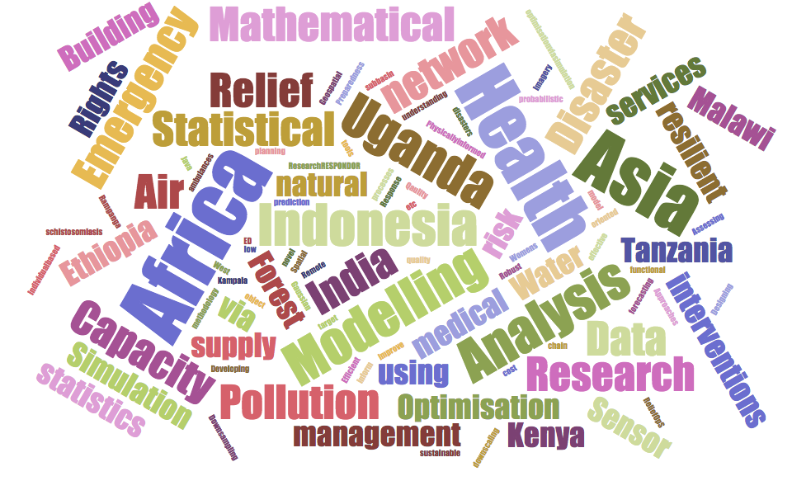
Wordcloud and current synergies
Notes:
The synergistic activities arising from this workshop will lead us to build a larger network of researchers, identify challenge driven research and/or capacity building calls which can be led by members of the mathematical sciences community.

Slide 9
Wordcloud and current synergies
Geographical focus
Africa
India
SE Asia
Application areas
Air pollution
Emergency Management
Water Quality
Public Health
Forest Management
Notes:
The synergistic activities arising from this workshop will lead us to build a larger network of researchers, identify challenge driven research and/or capacity building calls which can be led by members of the mathematical sciences community.

Slide 10








Will hear from
Notes:
The synergistic activities arising from this workshop will lead us to build a larger network of researchers, identify challenge driven research and/or capacity building calls which can be led by members of the mathematical sciences community.

Slide 11
Program –Day 1
Please join around 13:45 to sort out Breakout rooms
Notes:
The synergistic activities arising from this workshop will lead us to build a larger network of researchers, identify challenge driven research and/or capacity building calls which can be led by members of the mathematical sciences community.

Slide 12
Notes
2
Notes:
The synergistic activities arising from this workshop will lead us to build a larger network of researchers, identify challenge driven research and/or capacity building calls which can be led by members of the mathematical sciences community.

